Slide 1

Conditional GAN – Week 3
Ahsan Lohdi, Yang An
Technical University of Munich
Department of Informatics
Computer Vision Group
Garching, 21. May 2019

Slide 2
Last Week‘s recap and to do‘s
Tried the conditioning on CycleGAN -> didn‘t work, no training on A-to-A,
Take a look on MUNIT

Slide 3
Update on the Cycle GAN
Last week we discussed,
Introduce extra channels in data to condition the output.
IMAGE
Target
IMAGE
Problem: Training method does not incorporate all combinations of images to support conditional image generation.

Slide 4
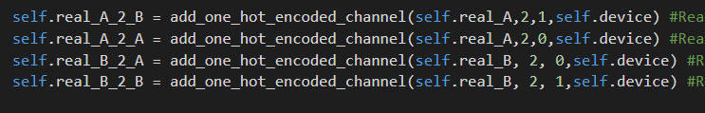
Solution: for each batch generate images with targets

Slide 5
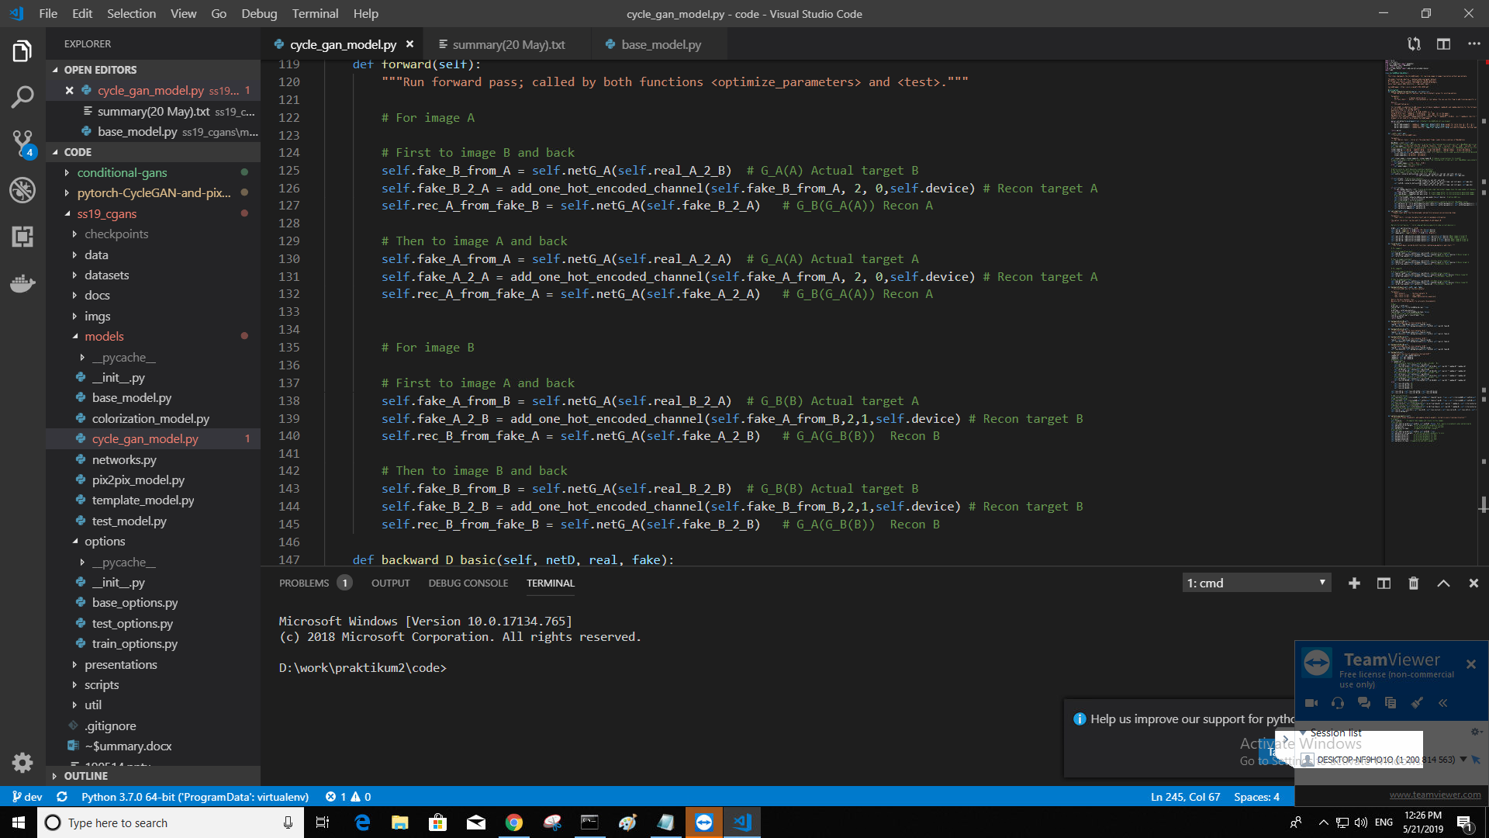
Solution: Forward pass for each case

Slide 6
Solution: calculate Discriminator loss for each case

Slide 7
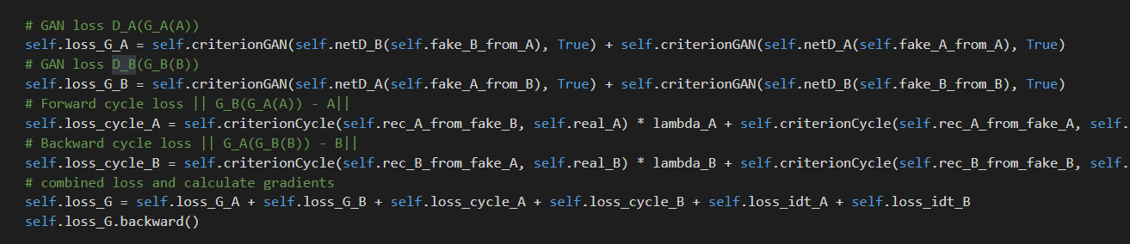
Solution: Add all losses together & perform a backward pass

Slide 8
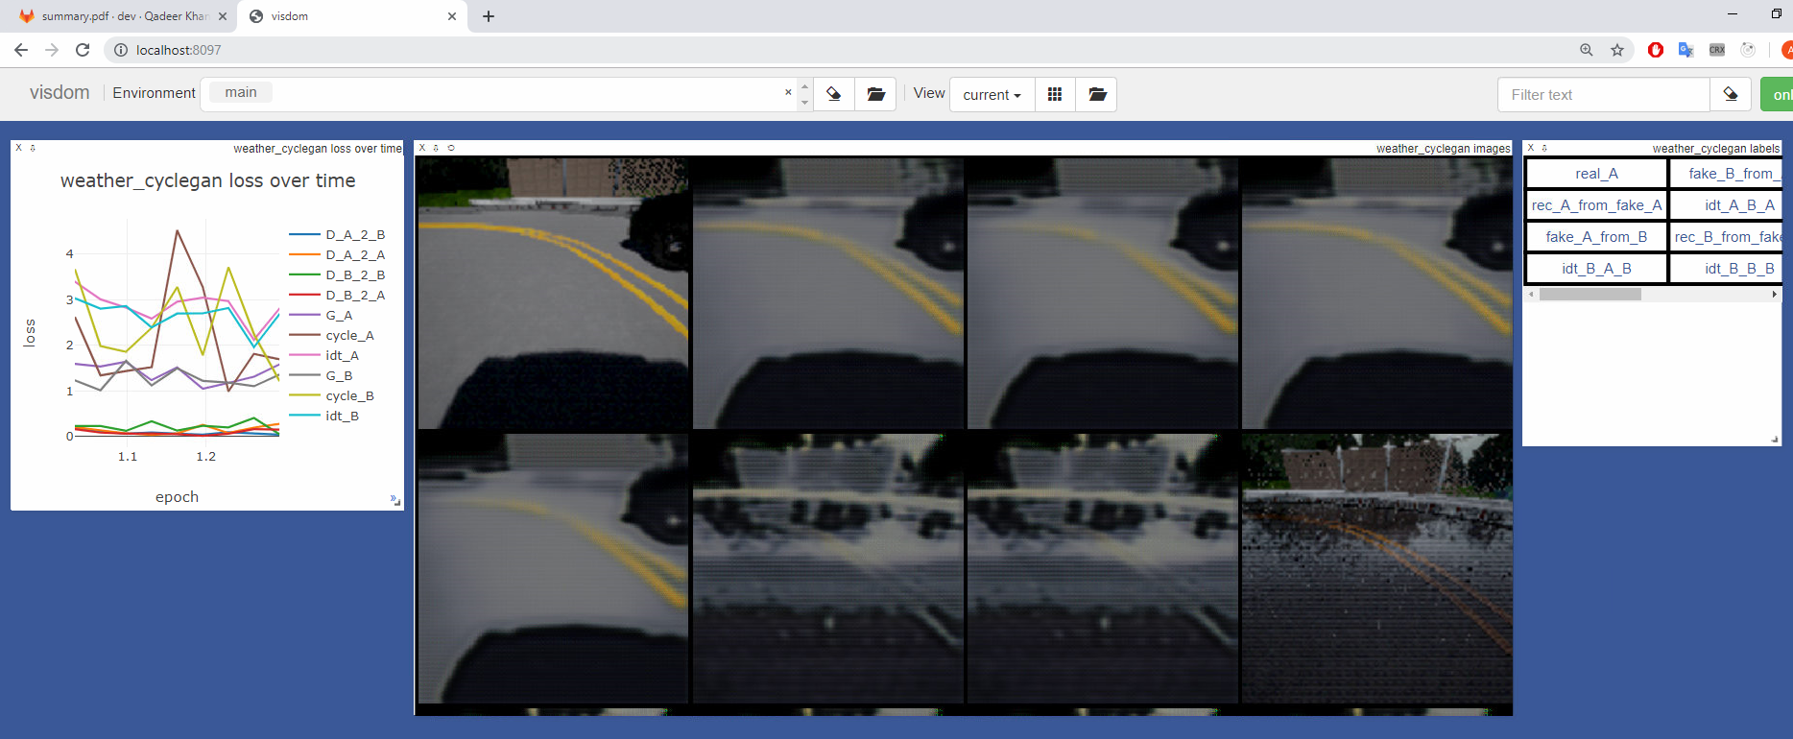
Results:
Expected: Conditioning based in extra channels.
What happened: Nothing!

Slide 9
What Next?
Figure out if we made a logical mistake
or if we need to change the training technique
or if we need to change the loss calculation
or if this concept is not supposed to work at all

Slide 10
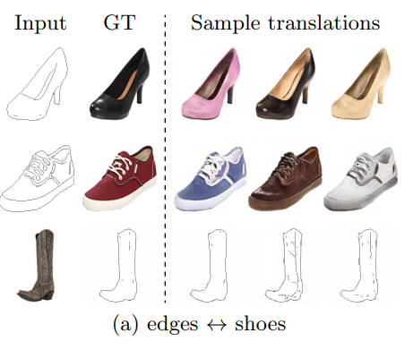
MUNIT – Multimodal Unsupervised Image2Image Translation

Slide 11
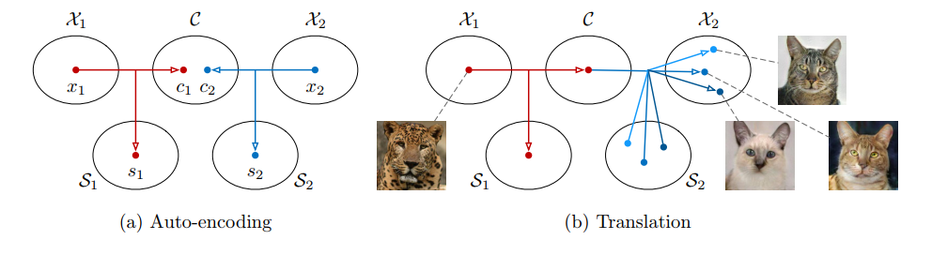
MUNIT – Encoding the image into „Content“ and „Style“

Slide 12
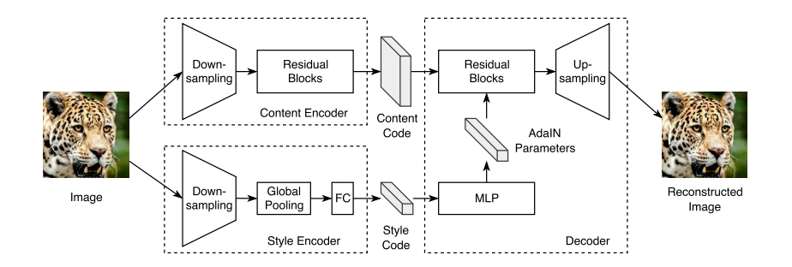
MUNIT – Architecture

Slide 13
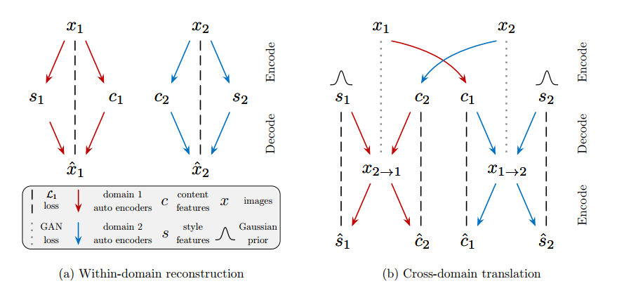
MUNIT – GAN and reconstruction loss

Slide 14
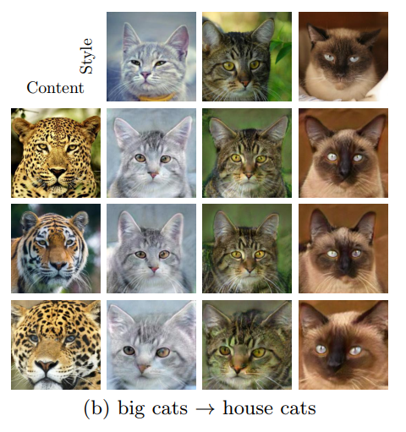
MUNIT – Use an example to „guide“ to the desired style
S1
X1
Encoder 1
Image with content X1 and style X2
C1
Decoder 2
S2
Guide X2
Encoder 2
C2

Slide 15
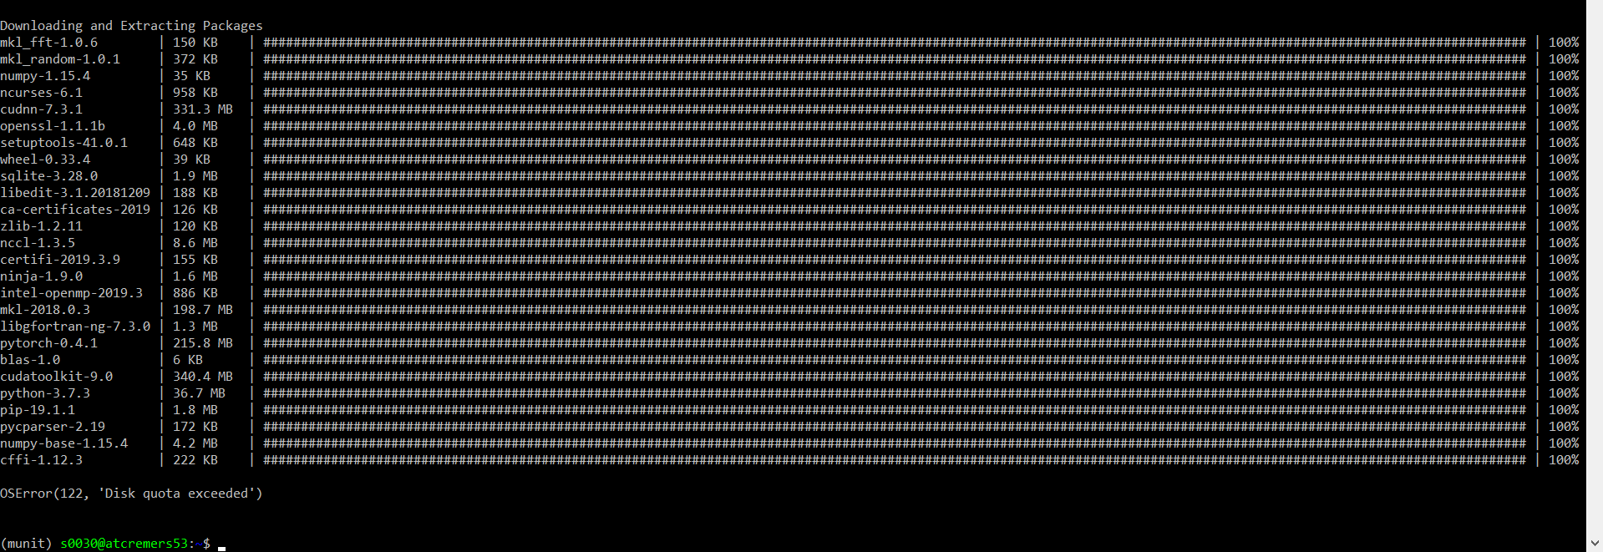
Challenge 1: Create Conda Env with Pytorch 0.4.1

Slide 16
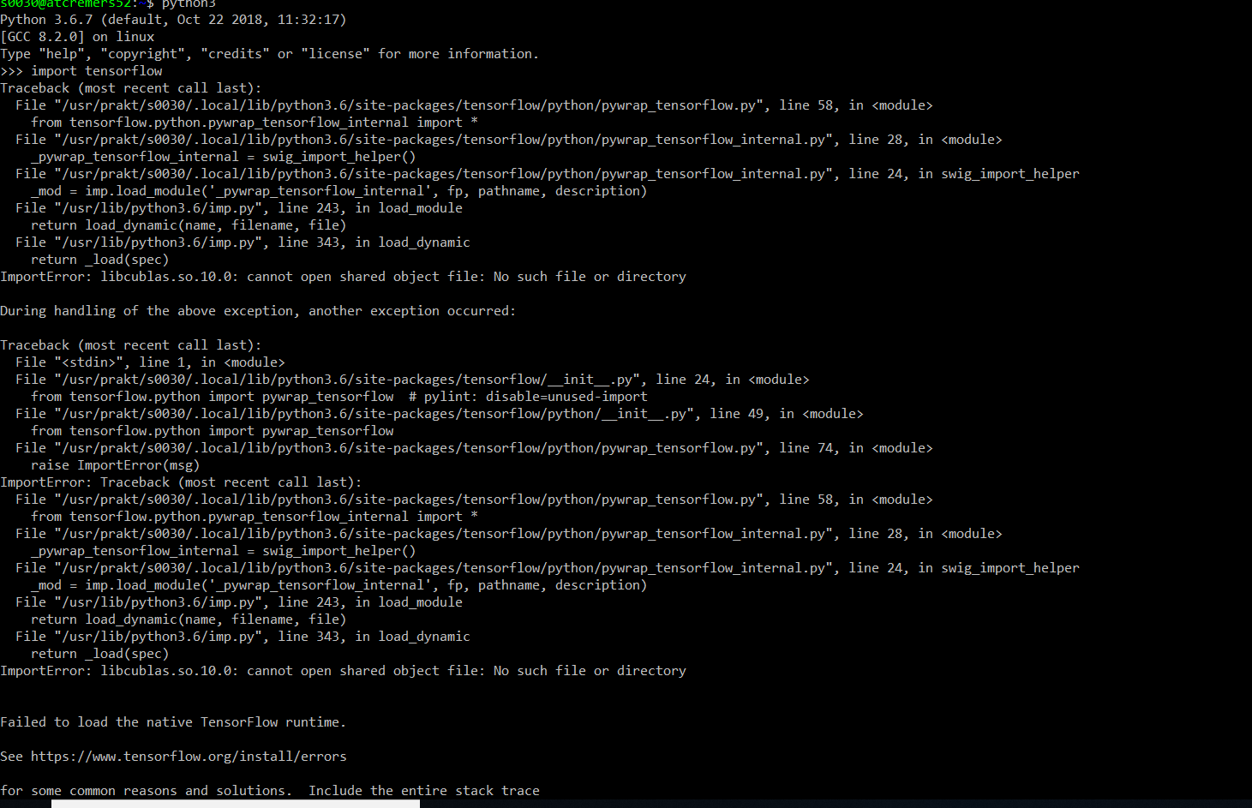
Challenge 2: Tensorflow-GPU doesn‘t work

Slide 17
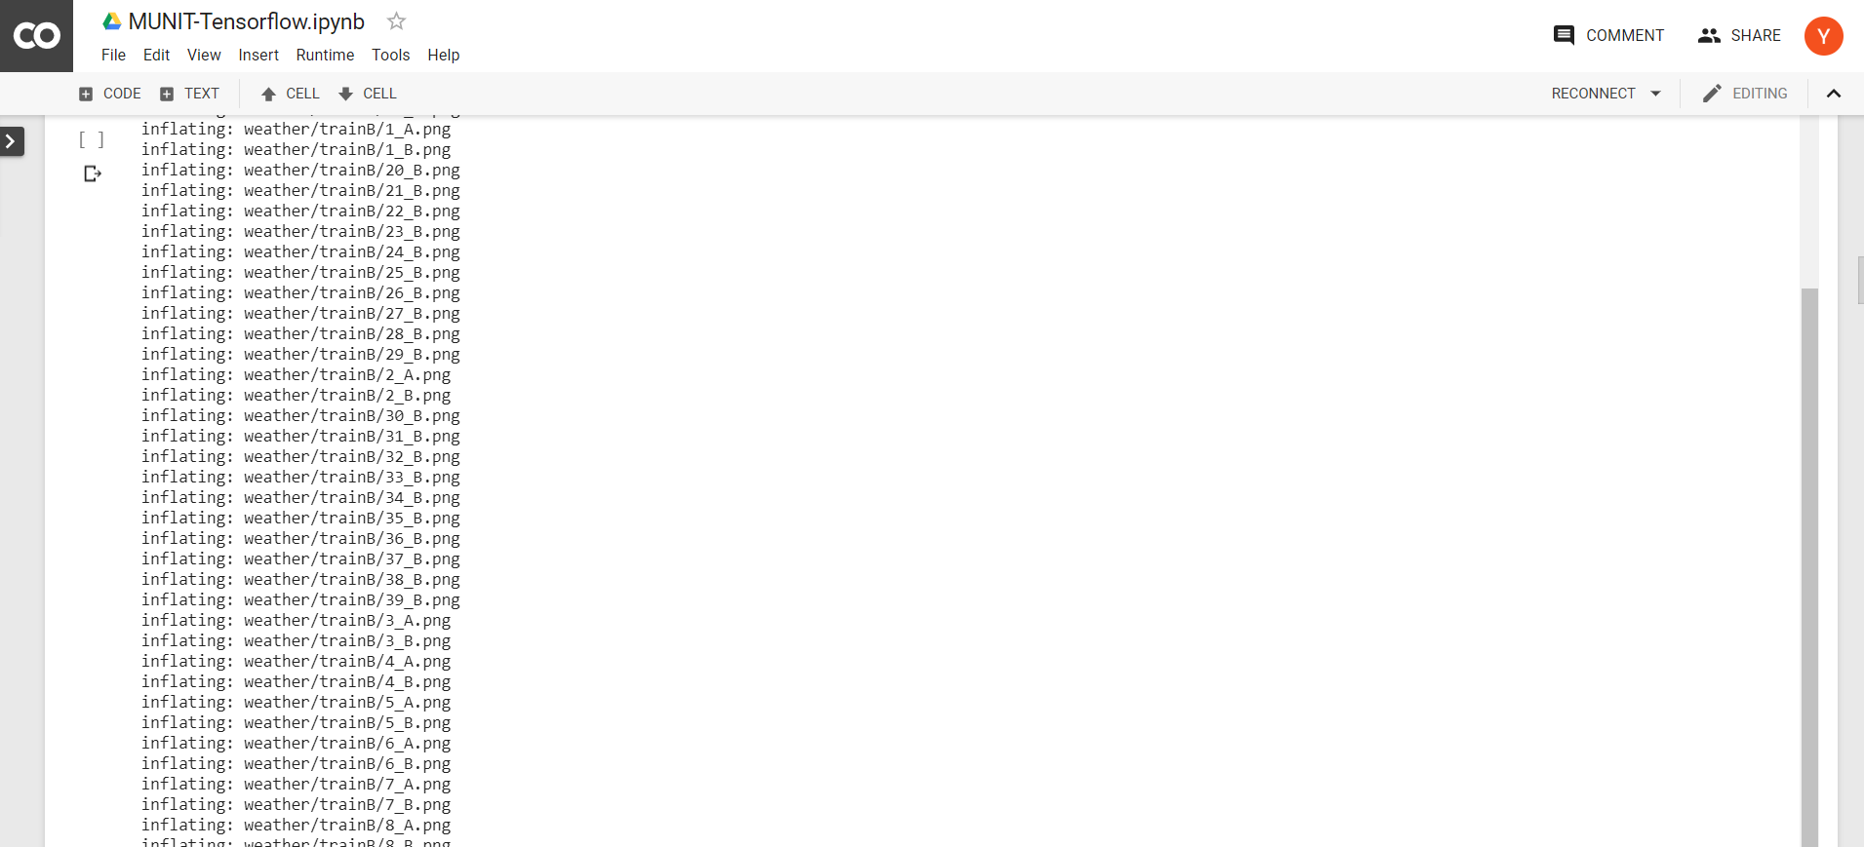
Workaround: Google Colab

Slide 18
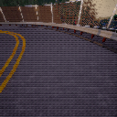
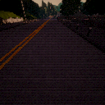
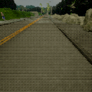
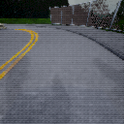
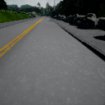
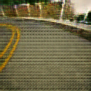
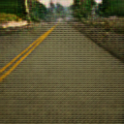
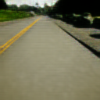
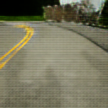
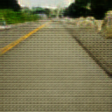
Results
Original
Image
Guide Image

Slide 19
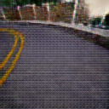
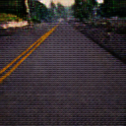
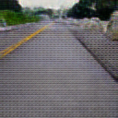
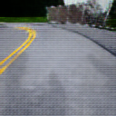
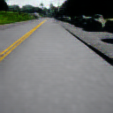
Results
Original
Image
Guide Image

Slide 20
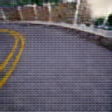
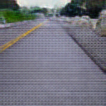
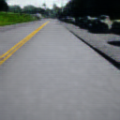
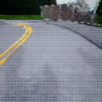
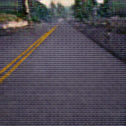
Results
Original
Image
Guide Image

Slide 21
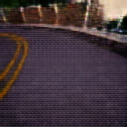
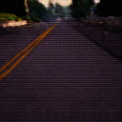
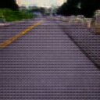
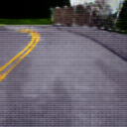
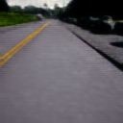
Results
Original
Image
Guide Image

Slide 22
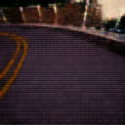
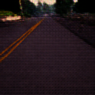
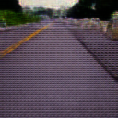
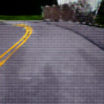
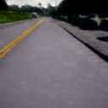
Results
Original
Image
Guide Image

Slide 23
What‘s next
Train on bigger dataset and longer to separate similar modes
Use other dataset

